Slide 1
SAP BO ADMIN TRAINING
Sadhu Pravalika Reddy
01st April 2019

Slide 2
Contents
1
Introduction to Business Objects
5
Health Checks
2
About SAP Business Objects
6
Auditing
3
Distributes Environments
7
Authenticaton
4
Business Objects Architectures

Slide 3
8
Enable Account
12
Promotion Management
9
User Access Request
12
Adding of TNS Entries
10
Clearing spaces in servers
13
Access levels
11
Performance issue

Slide 4
14
Tomcat cache clear
18
Server Management
15
Pausing reports under mentioned ID
19
User security
16
Liscence keys
20
Patching
17
Deleting Reports from Recycle Bin

Slide 5
21
Decommission Task
22
Adding Windows AD groups

Slide 6
1. Introduction to Business Objects

Slide 7
About SAP Business Objects
SAP Business Objects is a reporting Tool. It consists of a number of reporting applications that allows users to discover data , perform analysis and create reports.
Business Objects allows you to transform the data in databases into information that allows you to make better decisions. You can see and work with the data in professional looking reports. Business Objects is the program used for the corporate reporting service at the University.
Business Objects is a front end BI platform.
In BO data is not stored in the application level but integrated from the back end sources.

Slide 8
Distributed Environments Multiple BOSS environments in each region of the world Sandbox – VMware Based – for testing new versions, service packs, hot fixes and configuration changes Development – VMware Based Test – VMware Based OAT/Training – Dual VMware Based Web servers with 2 or more physical application servers. VMware based web server and physical application server for disaster recovery purposes. Production - Dual VMware Based Web servers with 2 or more physical application servers. VMware based web server and physical application server for disaster recovery purposes. Production Support – VMware Based environment purely for resolving production issues

Slide 9
Business Objects Architecture:- Client Tier Web Tier Intelligence Tier Processing Tier Data Tier

Slide 10
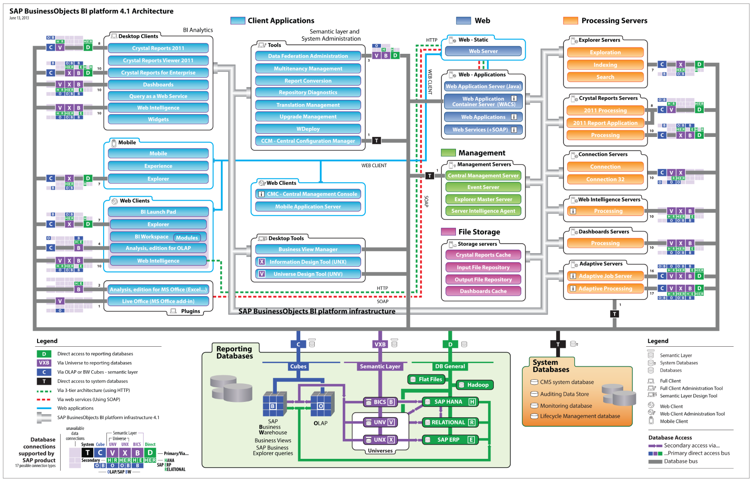

Slide 11
Health Checks
We perform Health Checks to make sure complete health of the system to be good so that daily activities can be carried out without any issues.
All the services should be up and running.
We need to check
Auditing
Monitoring
Instance Manager
Server space
Services
Monitor BEP,BHP, BRI health from time to time.

Slide 12
Auditing
All the actions that are performed on BO platform will be tracked by CMS. All the Audit data will be temporarily stored in Auditing folder. Auditee checks if there is any audit data on auditor at frequency of 3 minutes. If there is any data, it will be written to audit database.
Only last 90 days data will be available on audit database.
When the Audit is set to be:-
Off – Audit is disabled
Minimal – few set of events will be captured
Default – few more captured by default
Complete – All set of events will be captured
Custom – Selected events will be captured
Audit Thread Utilization means spending time writing data to the data base.
Last polling cycle 180 Sec, it means the Auditor will check whether there is a file, if there is a file then the file will be picked up by Auditor and writes to ADS (Audit data store).
If the Audit Thread Utilization is high will take the back up of audit files in the servers.

Slide 13
Authentication:-
Types of Authentications
Windows AD
Enterprise
LDAP
SAP
Oracle EBS
Siebel people soft enterprise
Jd Edwards
Except Enterprise rest of them are third party tools which can authenticate.
In order to authenticate Windows AD group the user must be added to respective AD group.

Slide 14
Enable Account
Login to the requested environment.
Go to users and groups
Search the user ID in the User list and go to properties.
If Account is disabled then enable it.

Slide 15
User Access Request
Open the requested Environment and Login to CMC
Go to users and groups and check the user I’D with the given model I’D( ID for cloning ).
If we find any windows AD group or WRJ or WRO roles is missing for the user when compared to the model I’D we will request the user to contact the respective administrative team to get the Access.
Boss Team doesn’t provide any access.

Slide 16
Clearing Spaces in Servers
Open the server – program files – SAP Business Objects – logging folder.
Check the logging folder if there is any information, and after that delete the old files from it.
And also check the software folder and with guidance delete the files in software folder.
Then check backup folder and with guidance delete the files in backup folder.
And also check Recycle Bin and clear if there is any data.
If there is any shadow space inform Wintel team to look into it.

Slide 17
Performance Issue
The measures to be followed when there is a performance issue:-
Check Instance Manager and check the failed reports and the error that the reports are failing on.
Then based on the issue restart APS, AJS, WEBI services in CMC.
And in Instance Manager check for long running reports and kill the reports which runs more than 4 hrs except publication reports for 6hrs.
Monitor whether all the job servers are picking up instances from time to time if not restart AJS respectively.
When we are not able to open web page even if the Tomcat is running. Check the event viewer then restart server.
When report refreshing seems to be slow, then check whether this case arising with individual web and app URL’s. If issue happens for all then restart webi services. Still issue resides then need to restart SIA in CCM with proper approval from seniors.

Slide 18
Promotion Management
1.LIVE TO LIVE
2. LIVE TO BIAR
Live to Live:- Select job name and then select source and destination folder and then create. Then the new job will be created and then test promote it ,after test promote got success click on promote. Then the job will be promoted in the destination folder. Then go to history and monitor whether the job got succeed or failed.
Live to BIAR:- Select job name and then select source folder and then destination folder as Biar file. And then click on Export. Now login to the destination Environment and click Import and then select destination folder and then promote. Then go to history and monitor whether the job got succeed or failed.
Manage dependancies:- We can select folder structure,universes and reports etc., through manage dependancies which we need to promote.
Not to select user security when promoting a job as it can effect top level security.
Promotion management is for same versions of environments.
Upgrade management is for different versions of environments.

Slide 19
Addition of TNS Entries
Open cyber arc with the server then go to
Computer - F Drive – Oracle – Oracle-64 – Oracle instaclient-10 – product – 11.2.0 – client-1 – Network – Admin – TNS names.
Copy the TNS names folder to the desktop. Rename the folder in the F Drive with the present date .
Open the folder which is on the desktop and add the given TNS entries in the folder and click on save.
We have to the add the entries in Oracle, Oracle-64, Oracle instaclient-10.
Perform Telnet and Tnsping.
We have to raise a change request for adding TNS entries in Prod servers.

Slide 20
Access Levels
Types of Access levels:-
View
View on Demand
Scheduling
Full control
We have predefined templates in Access Levels.

Slide 21
Tomcat cache clear
Open CCM(Central Configuration Manager) and stop TOMCAT.
Now go to Computer – F Drive – program files – SAP Business objects – Tomcat – work – catalina – local host.
Now rename Local host as Local host_old and then restart Tomcat.
Tomcat will take more time to build cache. During this period we should closely monitor the system.

Slide 22
Pausing reports under mentioned NT ID
Open the URL requested by the user.
Then open Instance Manager in CMC and enter the NT ID of the owner in Owner box and change the status to Recurring then click find.
Select the report and then right click and then pause.
In this way we can pause reports of the User.

Slide 23
License keys
License keys are of TWO Types.
Named License keys
Concurrent License keys
Named License keys means that the access will be provided with the particular name of the user. So, he can access the Environment at any Instant.
Concurrent License keys means there will be a limit to be set for the number of users to access the Environment.
If the count exceeds the limit then the user will be unable to access the Environment.

Slide 24
Deleting Reports from Recycle Bin:-
Open the Environment and then login to CMC with administrator account , then go to Recycle Bin. Now Identify the report requested by the user which need to be deleted from Recycle Bin.
Select the Report, then right click and then delete.

Slide 25
Server Management
Accessing the servers using CMC and CCM
Enabling, Disabling, Starting , Stopping, Restarting and Force terminating of services.
Purpose of each and every server.
Understanding the role of each service.

Slide 26
User Security
Creating a User
Creating a Group
Assigning Security
Folders
Universes
Connections
Applications
Inheritance
User over a group

Slide 27
Patching:- Disable AJS in all the nodes and disable the monitoring application in applications. Stop SIA/Tomcat in web and app servers and made changes from automatic to manual in properties. After the patching activity is completed check whether the patch is installed or not in Control Panel-> Installed programms with date modified. Check in the task manager whether the server is rebooted or not. Make the changes from manual to automatic and then reboot the servers one by one. After rebooting the servers check SIA and CMS are running in task manager. Check all services are up and running fine in CMS servers. Send the communication mail. Perform Health Check. If the patching activity is not done contact patching team with respective environments.

Slide 28
Decommission Task Go to the respective folder in CMC/BI which user wants to decommission. Right click on the folder,then click on user security. Take snippets for reference and then remove access. Similarly remove access to folders in universes, connections and users and groups. After completing the activity in the non production environments inform user for confirmation to proceed with production environment. Before making changes to production environment need to raise a change request. Perform changes in the production environment with respect to the time in change request.

Slide 29
Adding Windows AD groups Go to Windows AD in athentications under CMC and add the Windows AD group by clicking add item. It will be saved under group hierarchy in users and groups . Add it under the enterprise group which user needs.

Slide 30
Thank you

